Slide 1
Predicting the Outcome of A Shot
—Multivariate Data Analysis
Team: Haitao Liu, Yang Liu, Jiawei Xue
Instructor: Amir H Gandomi
Nov 20th, 2018

Slide 2

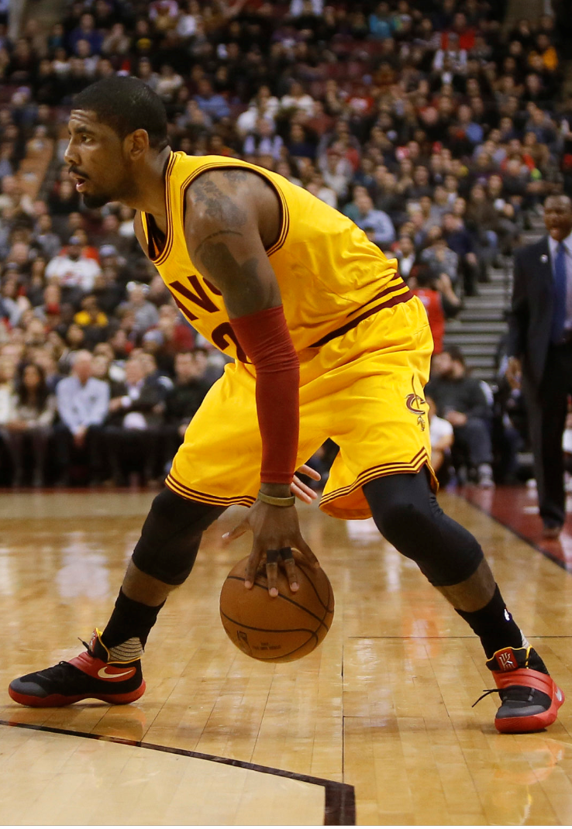

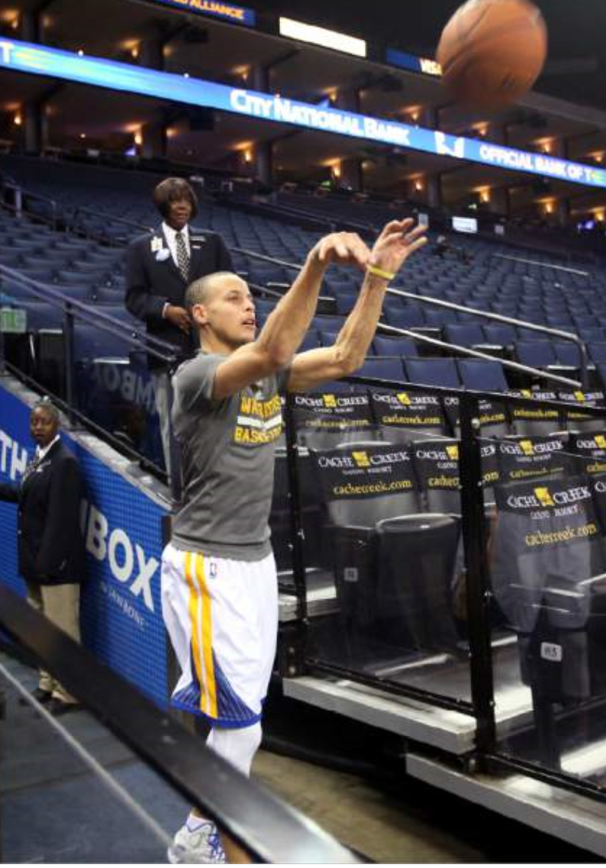
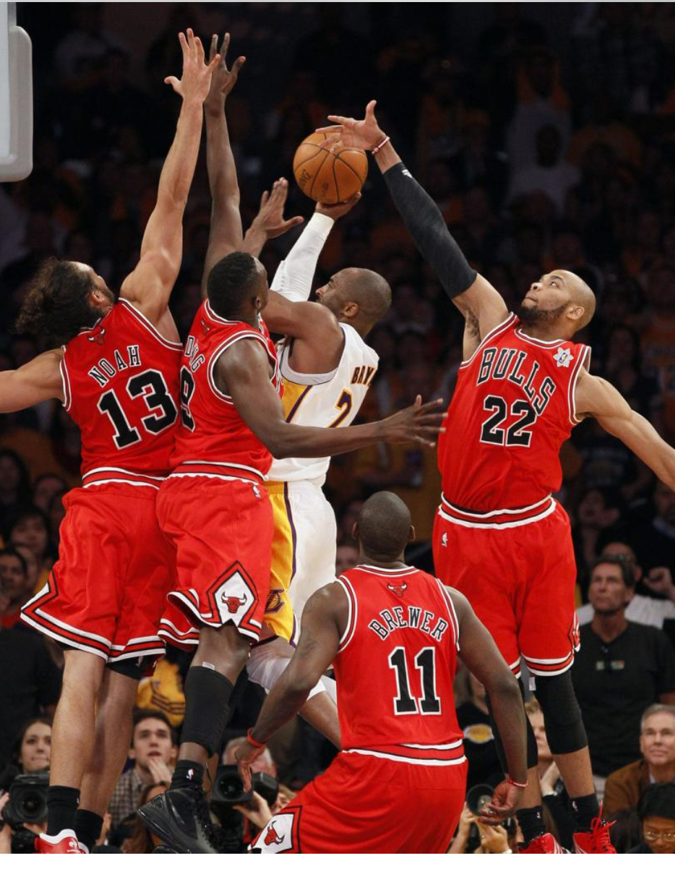

Introduction

Slide 3
Data Understanding
Independent Variables | Interpretation
Location | Place where a game is taken (Home/Away)
SHOT_NUMBER | Order of one shot from one player in a game (≥1)
PERIOD | Order of each quarter in one game (1-4)
GAME_CLOCK | Past time in each period (0:00-12:00)
SHOT_CLOCK | Remaining time of each offense time (24s-0s)
DRIBBLES | Times of dribbles from catch to shoot (≥0)
TOUCH_TIME | Past time from catch to shoot (≥0)
SHOT_DIST | Distance from shooting position to the rim(0-94feet)
CLOST_DEF_DIST | Distance from shooter to defender (0-94feet)
Dependent Variables | Interpretation
FGM | Outcome of a shot, made or missed (1 or 0 )

Slide 4
One Hot Encoding
Location
Original
Away
Home
Encoded
1
0

Slide 5
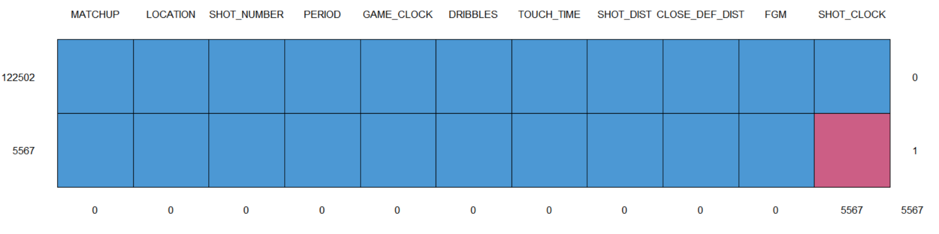
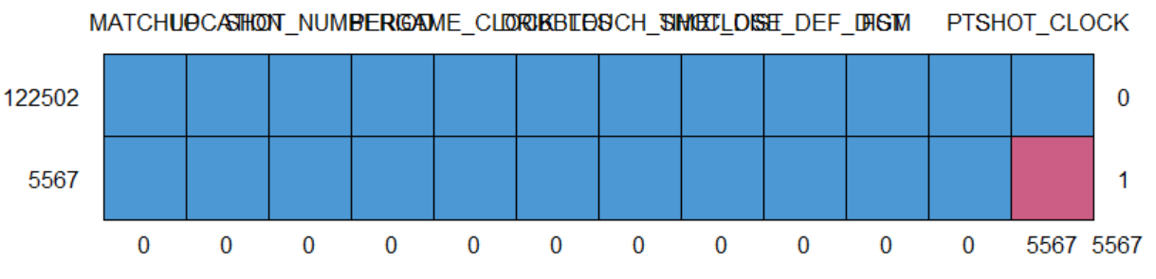
Identify Missing Values

Slide 6
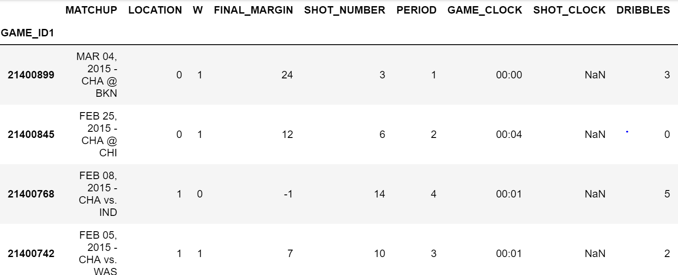
Imputation of Missing Values
Type: Nonrandom missing data
Imputation method: replaced by 0

Slide 7
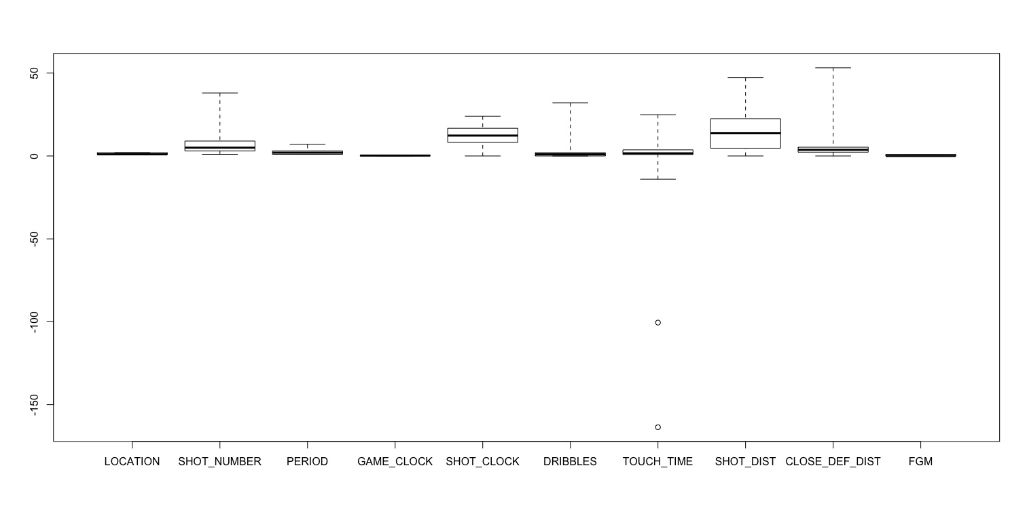
Detection of Outliers
Outliers
Instances:312 rows
Imputation method: replaced by mean
Reasons:1. prefer to analyze the whole dataset 2. outliers is a small proportion

Slide 8
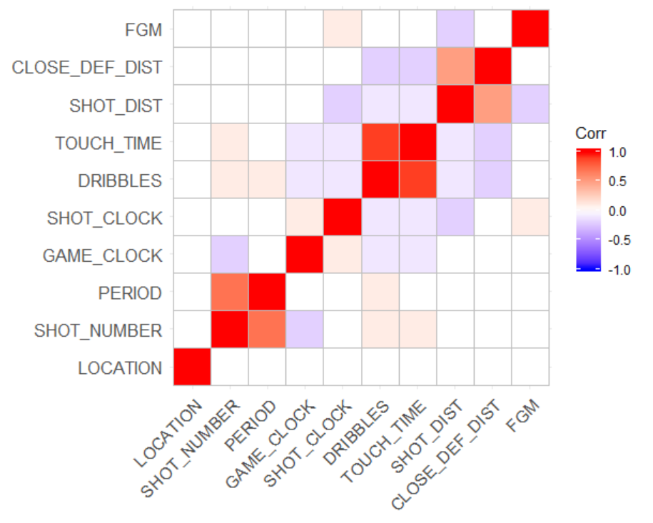
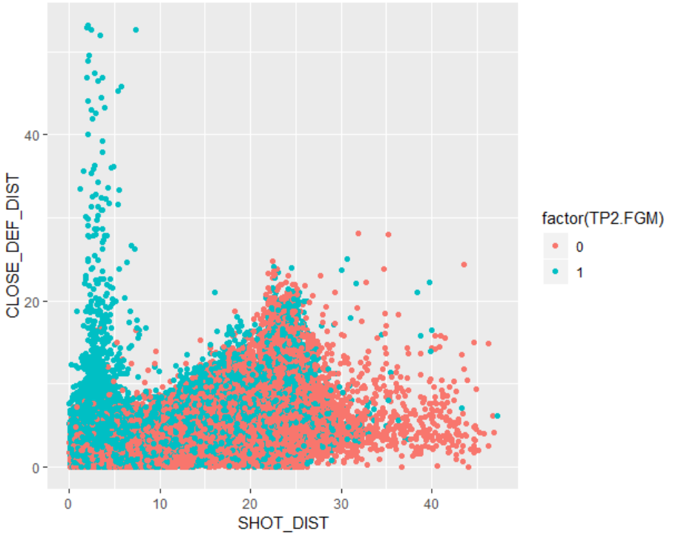
Correlation Matrix

Slide 9
Further Steps
Check normal distribution
Standardize the variables
Split the dataset into the training and testing subsets in a ratio of 4:1

Slide 10
PCA

Slide 11
Classification
Linear Discriminant Analysis
Logistic Regression
Knn
Naïve Bayes
Decision Tree
XGBoost

Slide 12
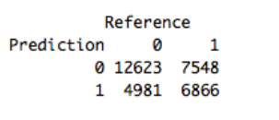
Linear Discriminant Analysis
Variables | Coefficients
Location | 0.030417
SHOT_NUMBER | 0.069139
PERIOD | -0.063289
GAME_CLOCK | -0.003062
SHOT_CLOCK | 0.189139
DRIBBLES | 0.268415
TOUCH_TIME | -0.445654
SHOT_DIST | -1.100173
CLOST_DEF_DIST | 0.531372
Confusion matrix
Accuracy:0.6072

Slide 13
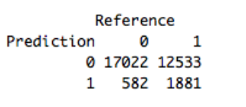
Logistic Regression
Variables | Coefficients
Location | 0.014748
SHOT_NUMBER | 0.034571
PERIOD | -0.031256
GAME_CLOCK | -0.001406
SHOT_CLOCK | 0.091964
DRIBBLES | 0.126799
TOUCH_TIME | -0.211341
SHOT_DIST | -0.542158
CLOST_DEF_DIST | 0.279260
Intercept | 0.198505
Confusion matrix
Accuracy:0.5904

Slide 14
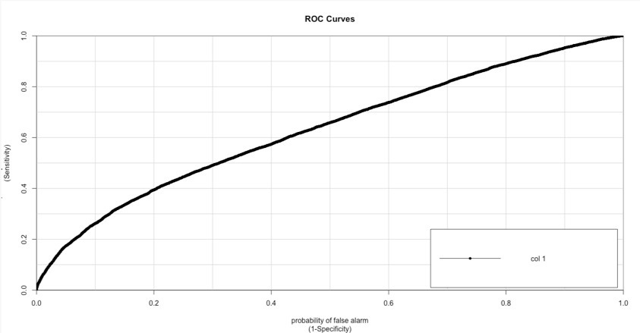
Knn & Naïve Bayes
Naïve Bayes:0.5941

Slide 15
Improve Accuracy
No PCA
XGBoost
Ensemble

Slide 16
XGBoost
Extreme Gradient Boosting
Efficient Algorithm
Tree based booster
logistic regression learner

Slide 17
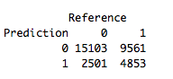
XGBoost
Result:
Importance Matrix
Confusion matrix
Accuracy:0.6323

Slide 18
Ensemble
Ensemble Stacking:
Bottom layer models
k-fold cross-validation
Make prediction
Top layer model
Feature sets

Slide 19
Ensemble
Two layers of machine learning models:
Generalized Boosted Regression
Naïve Bayes
LDA
Logistic regression
Decision tree
Top layer model
Bottom layer models

Slide 20
Ensemble

Slide 21
Conclusion & Future work
XGBoost and LDA
Not Ideal Enough
Improvement
More data
More Characters
Making Playing Strategies

Slide 22
Haitao Liu, hliu65@stevens.edu, (201)-616-8719
Yang Liu, yliu249@stevens.edu, (201)-985-4435
Jiawei Xue, jxue4@stevens.edu, (201)-985-4433

